Slide 1
Zerli Explain app

Slide 2
Order Screens

Slide 3
Login Window - Customer
Enter User Name Password

Slide 4
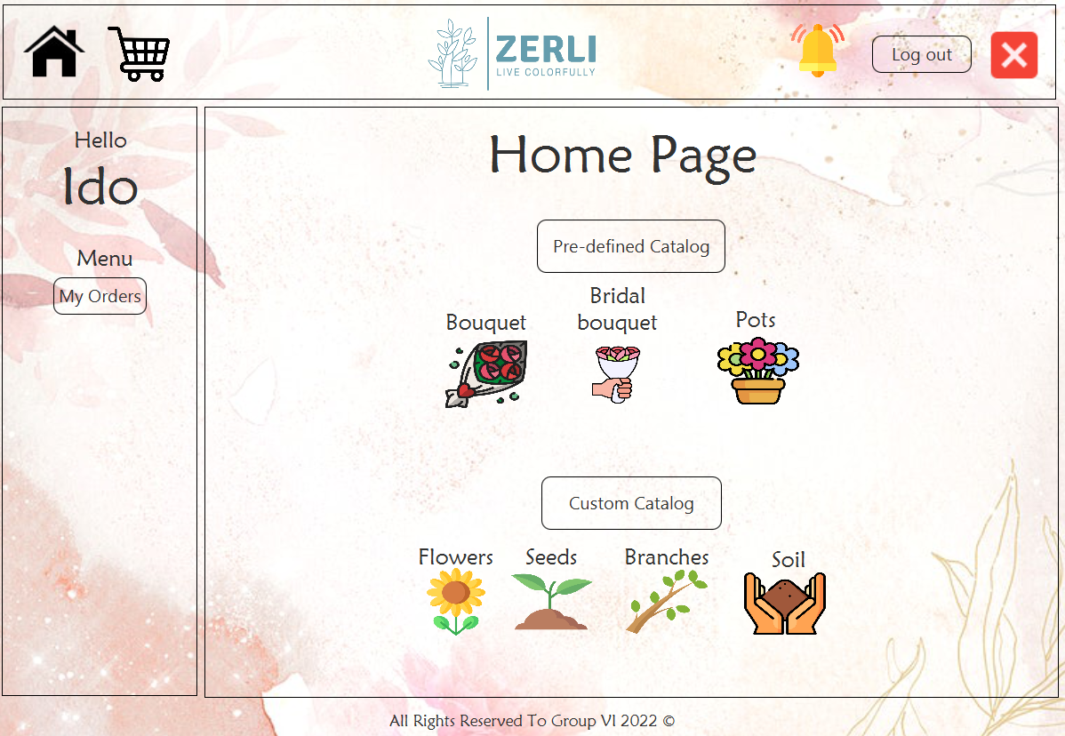
Home page - Customer
Tools window - Always displayed throughout all interactions
Customer menu pop-up - Always displayed throughout all interactions
Dynamic window - This window will load the relevant interaction each time.

Slide 5
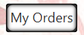
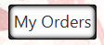
Home page - Customer
Notification icon - When there is a notification for the customer (such as order confirmation), a red circle will be displayed above this icon.
Cart window button
Logout button
Home page - Customer window button
Close button (X) - Window closure
Upon pressing any key, to create a click effect for the user, the key should have a hover animation when the mouse passes over it
Upon clicking, there should be a pressed effect where the key slightly shrinks, and then returns to its original size upon releasing the key
Order window button

Slide 6
Home page - Customer
The user navigates through catalogs using the keys. Additionally, product names and images are displayed so that the customer can identify the products available in each catalog.

Slide 7
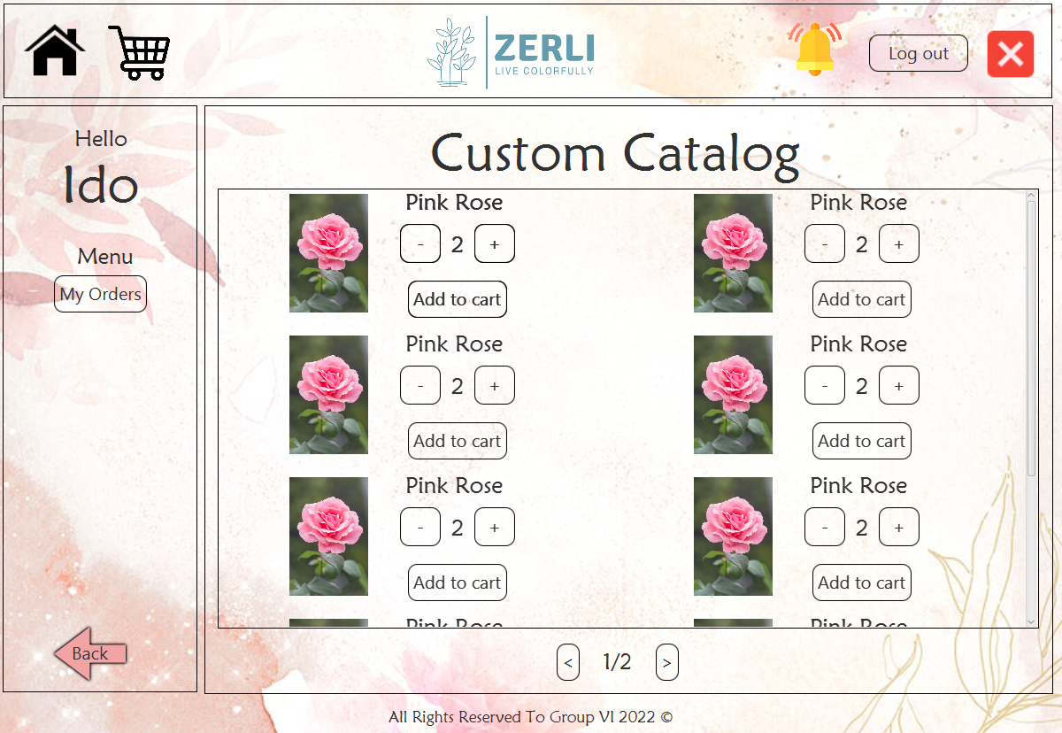
Personalized Matching Catalog Window - Customer
Each displayed product has the following fields:
1.Image
2.Product Name
3."+" and "-" buttons for quantity selection
4.Text indicating the quantity of the item
5."Add to Cart" button
Additionally, there is an indicator for the current page number to prevent excessive scrolling.
Back Button
Return to Home Page - Customer Window

Slide 8
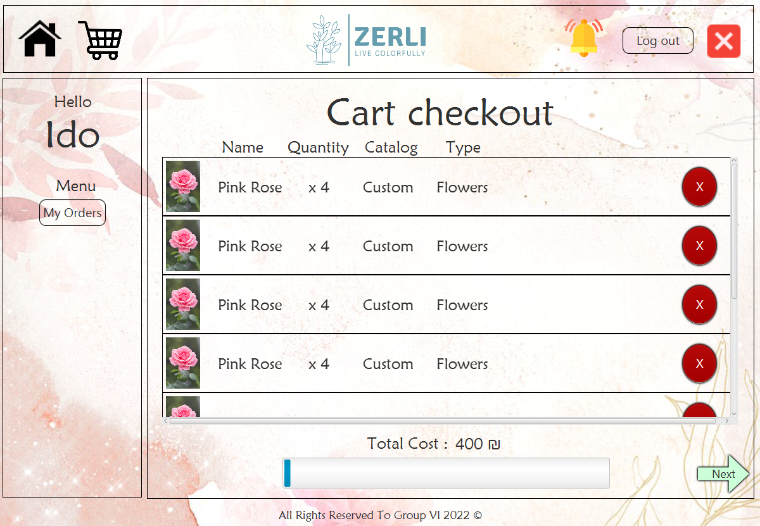
Cart Window - Customer
The customer can click on the cart icon in any window - after clicking, they will be redirected to the cart window.
For each product displayed in the cart, there are the following fields:
1.Image
2.Product Name
3.Quantity
4.Belongs to Catalog
5.Item Type
5."X" button to remove the item from the cart
This window includes scrolling for user convenience.
total amount for the cart is displayed.
Order progress indicator
"Next" button for proceeding with the order

Slide 9
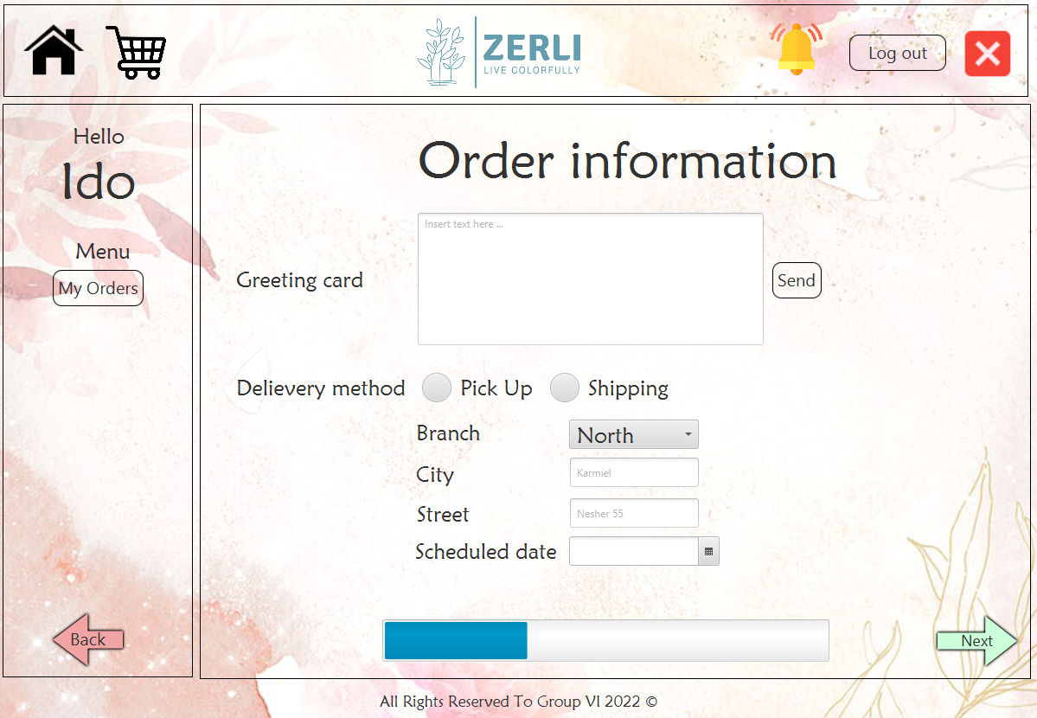
Order Details Window - Customer
Greeting Input Dialog:
1.Enter text in the text box.
2.Click the "Send" button to confirm.
Order Type Selection:
1.Delivery or In-store Pickup
2.Branch
3.City
4.Street
5.Delivery Date
Order progress indicator
Return to Home Page - Customer Window
"Next" button for proceeding with the order

Slide 10
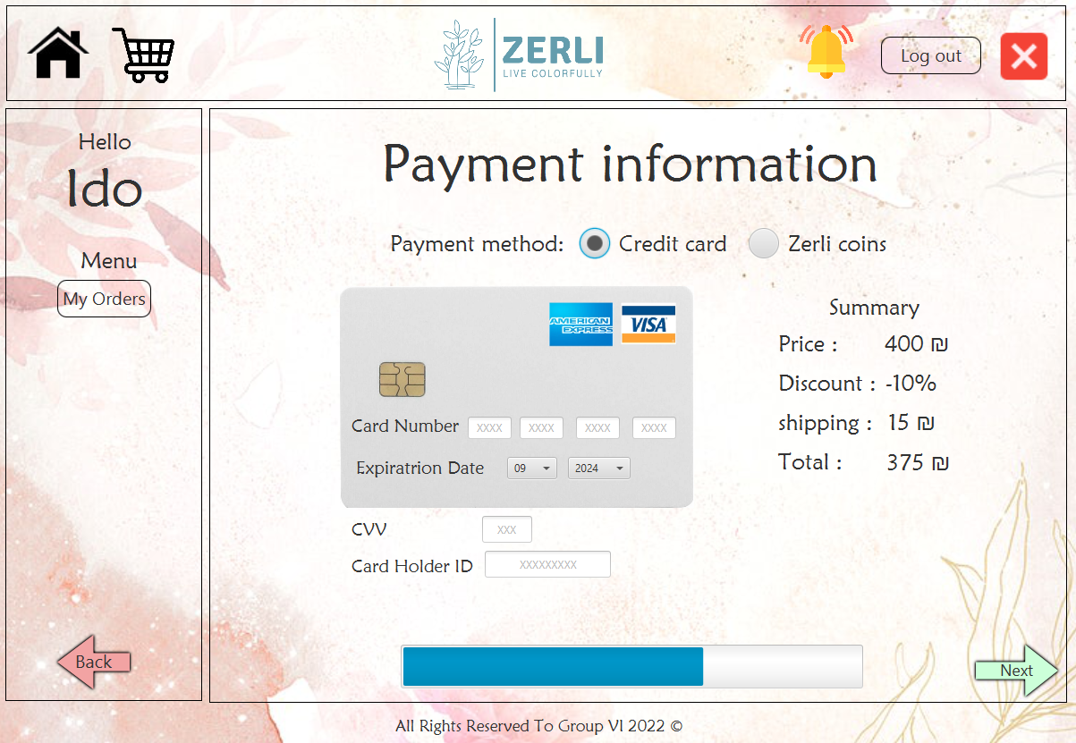
Payment Window - Credit Card Option - Customer
Payment Type Selection:
Credit Card / Points from Account
Credit Card Payment Dialog:
1.Card Number
2.Expiry Date
3.3-Digit Code
4.Customer ID (ID Number)
Order Summary:
1.Initial Order Price
2.Discount Amount (0 if none)
3.Shipping Cost (0 if none)
4.Final Price
Order progress indicator
Return to Home Page - Customer Window
"Next" button for proceeding with the order

Slide 11
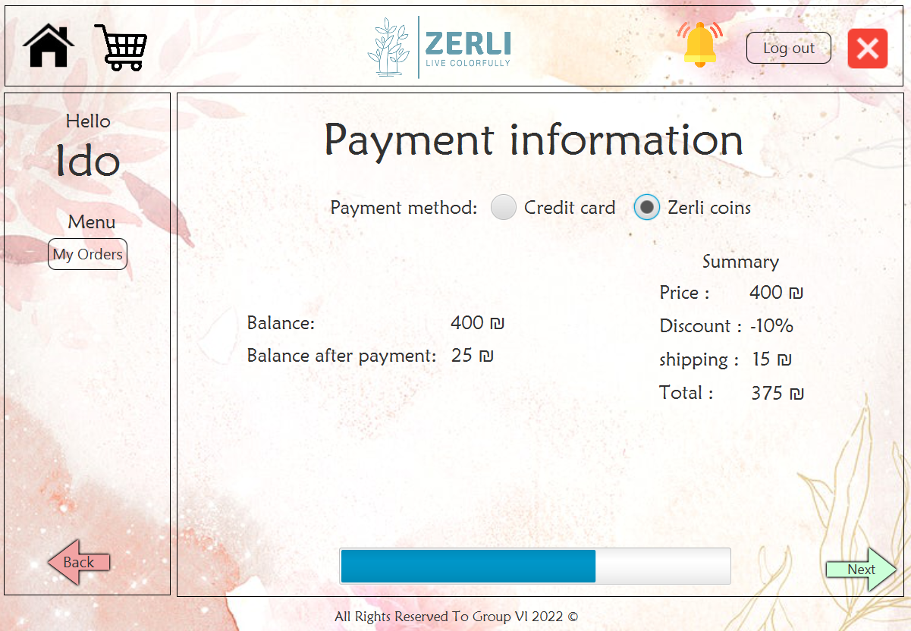
Payment Window - Choosing Points Option - Customer
Payment Type Selection:
Credit Card / Points from Account
Payment Dialog with Points in the Account:
1.Accumulated points until now
2.Points remaining after deducting the bill
Order Summary:
1.Initial Order Price
2.Discount Amount (0 if none)
3.Shipping Cost (0 if none)
4.Final Price
Order progress indicator
Return to Home Page - Customer Window
"Next" button for proceeding with the order

Slide 12
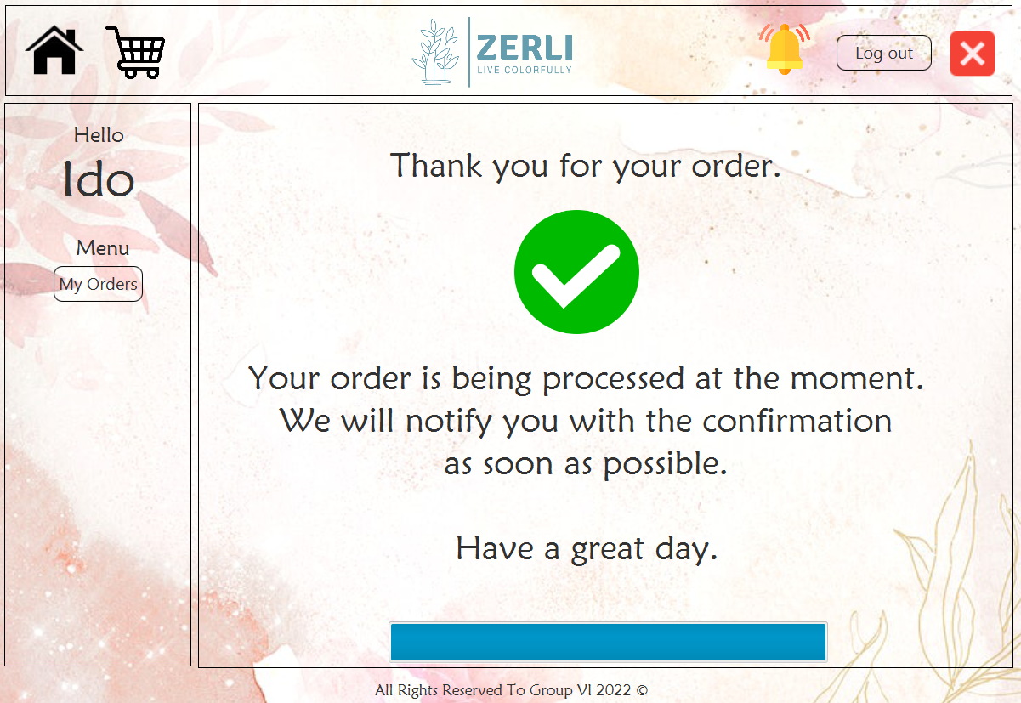
Order Confirmation Window - Customer
After filling in all the required details we've seen in the previous tabs, the order is sent for approval to the administrator. Additionally, the customer is notified about the order processing.
When the administrator approves an order, a notification symbol will appear on the notification icon.

Slide 13
Report Screens

Slide 14
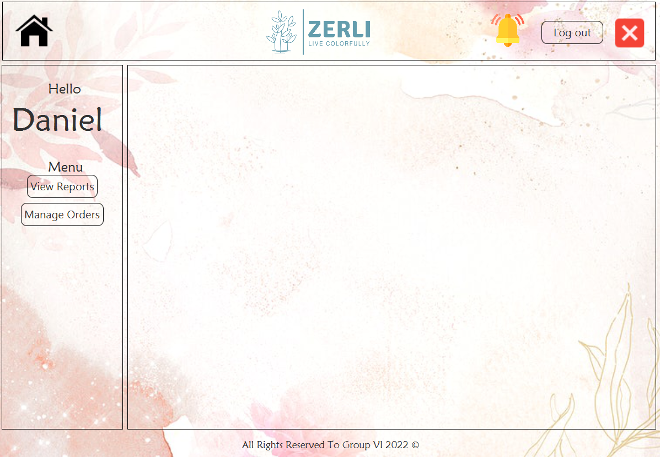
Home Page Window - Administrator
Tools Window - Always displayed throughout all interactions
Administrator Menu Window - Always displayed throughout all interactions
Dynamic Window - This window will load the relevant interaction each time.

Slide 15
Home Page Window - Administrator
Notification Icon - When there is a notification for the customer (such as order confirmation), a red circle will appear above this icon.
Button for Home Page Window - Administrator
Logout Button
"X" Button - Close Window
Button for Reports Creation Window
Button for Order Management Window

Slide 16
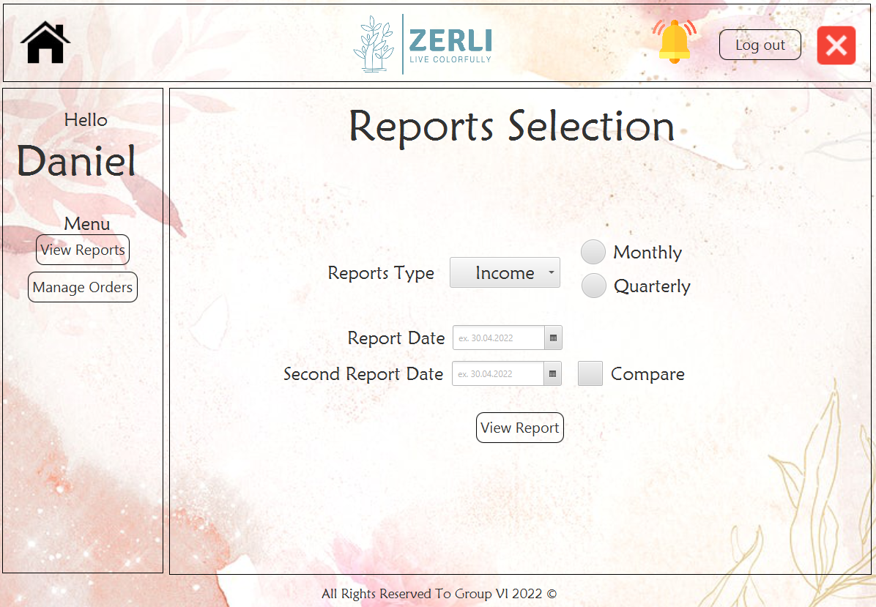
Reports Creation Window - Administrator
Choosing Report Type - Orders / Revenue / Satisfaction
Additionally, select whether the report is monthly/quarterly.
Clicking this button will take us to a screen as shown in the image.
Choosing the Date for the Report
If the administrator checks the "Compare" option in the dialog, an additional selection for the second date will open, allowing the comparison of two reports.
"Show Report" Button

Slide 17
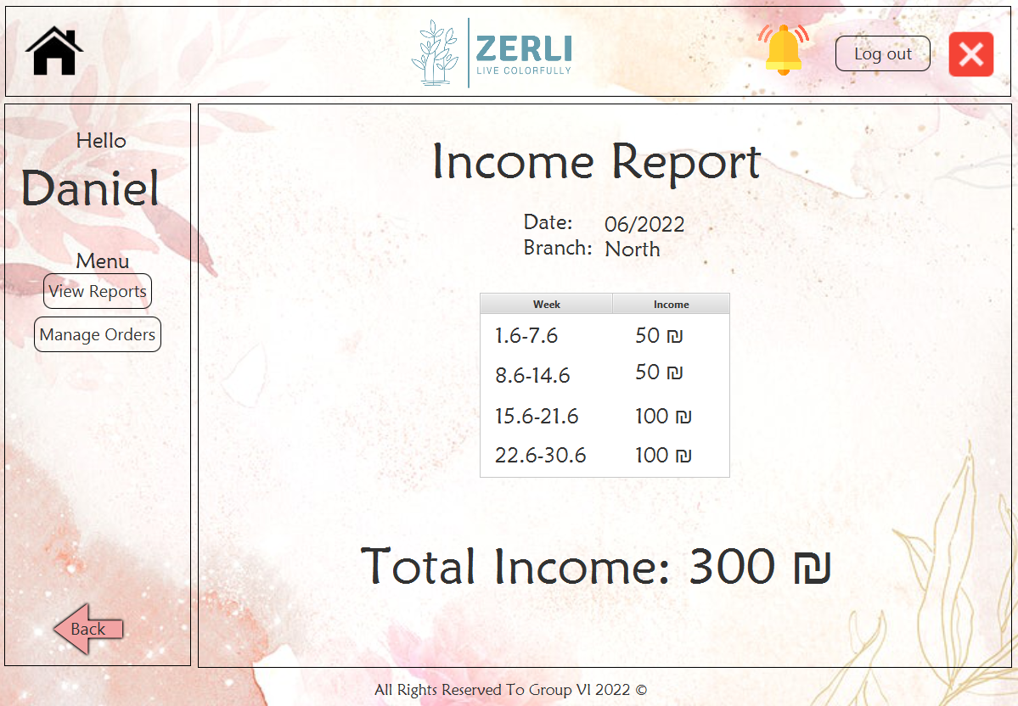
Report Display Window - Revenue - Administrator
Displaying Report Details - Date and Branch
Displaying a table divided into 4 weeks, as described in the image. Weekly revenue will be shown for each week.
"Back" Button
To return to the Reports Creation Window - Administrator
Displaying the total revenue for the selected month and branch.

Slide 18
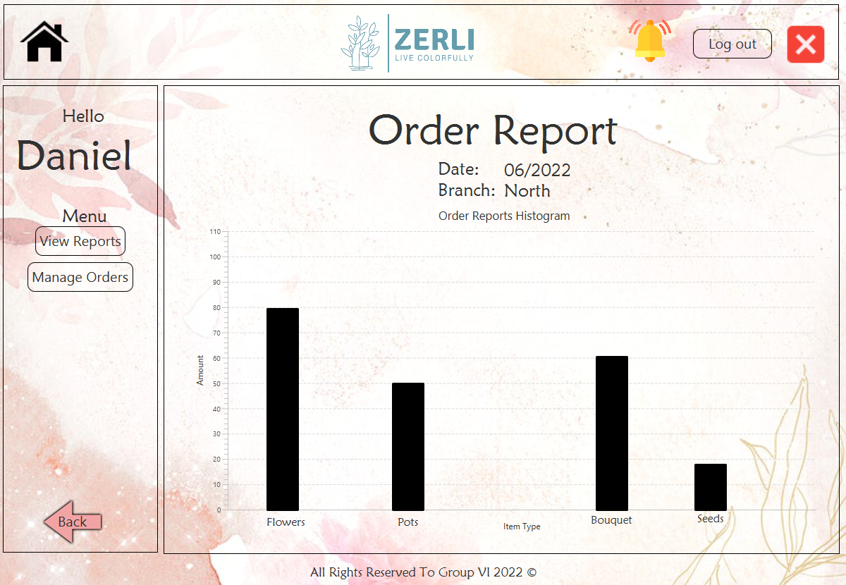
Report Display Window - Orders - Administrator
Displaying Report Details - Date and Branch
Presenting a column histogram divided into item types. Each column is adjusted in height according to the amount of that item type in the selected month.
"Back" Button
To return to the Reports Creation Window - Administrator

